Slide 1
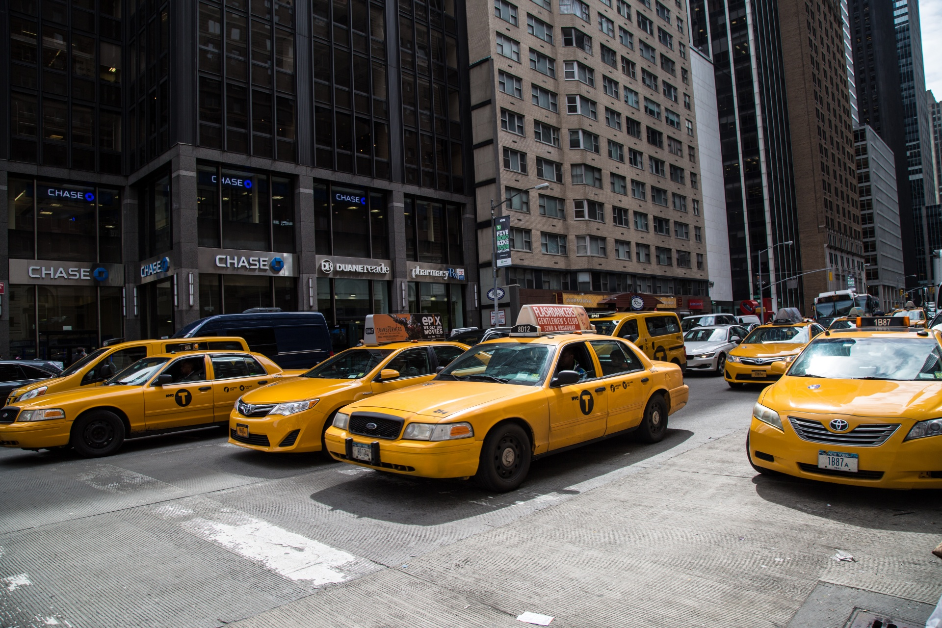
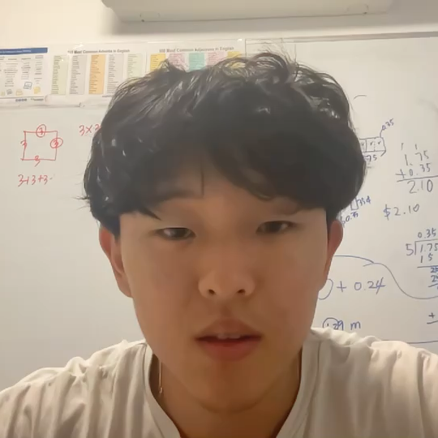
INFS 4205: Report
URBAN MOVEMENT: Spatial Temporal Data Analysis using Taxi Drivers of Porto, Portugal
Daniel Choi 46773713
Notes:
Hello, I’m Daniel Choi and my report is “Urban movement, Spatial Temporal Data Analysis using Taxi Drivers of Porto, Portugal”.

Slide 2
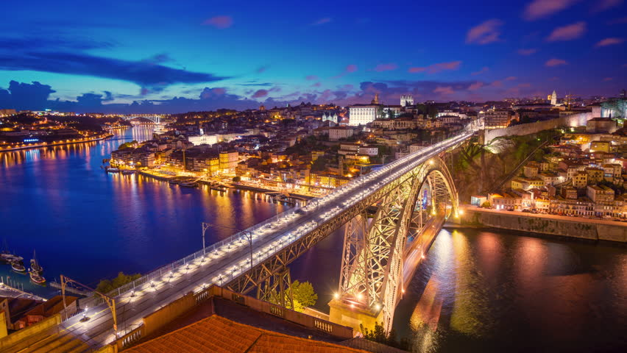

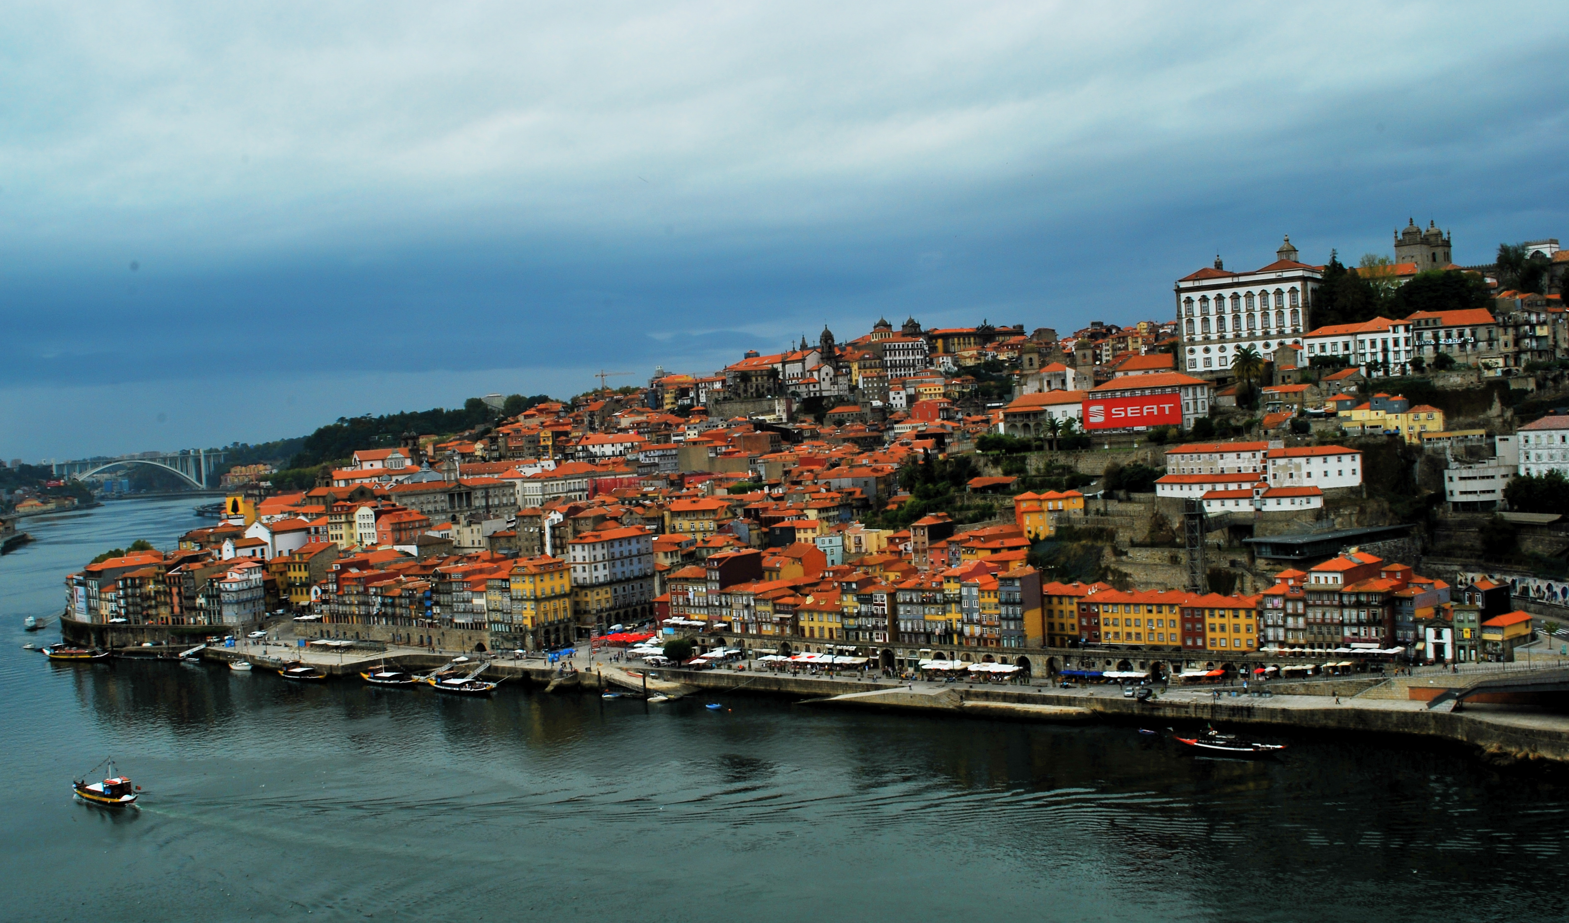
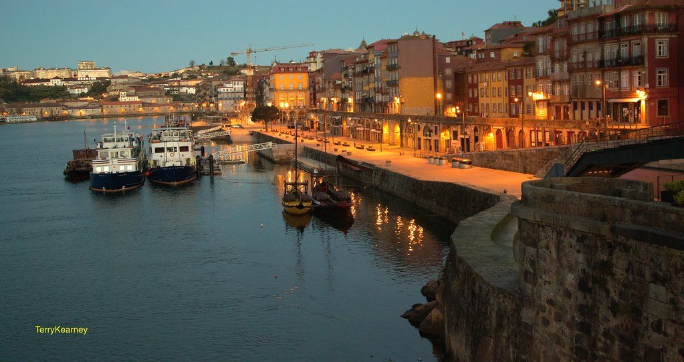
Dataset & context
Porto
City in Portugal
Rows
1,703,650 records
Attributes
9 columns
Notes:
I believe that the transportation system is a core functionality of every modern society which enables countless citizens from workers to students to reach their desired destination. Out of these numerous types of transportation, taxis have been one of the most prominent of the public transportation system enabling the customer a direct point to point travelling method. As such, this analysis will focus on the dataset of taxi drivers of Portugal from Kaggle.

Slide 3

Course content
PostgreSQL – Practicals & tutorials
Gaining familiarity with the program
Practice queries
Staging table
INDEXING METHODS
Understand why certain indexes more efficient
Which indexes to implement depending on query type
Trade-off between memory usage, creation time and execution time
Notes:
Course material which covered the functionality of the indexes greatly aided in the completion of the project as it provided a deeper understanding of why certain indexes were more efficient than others and causes of the trade-off between metrics of the indexes.

Slide 4

Progress & Key challenges
Time
GIST
GIN
Time to execute certain queries were extremely long
Additional columns:
start_point
End_point
Additional column:
Call_type_str
Notes:
The progress on the report was mostly consistent except for couple disruptions.
Using GIST:
Additional columns “start_point” and “end_point” had to be created as PostgreSQL refused to utilize the created GIST indexes when the query contained ST_StartPoint() and ST_EndPoint() within ST_Intersects(). USING GIN:
Similarly, to use the GIN index on the “call_type” column, an extra “call_type_str” column was created where the type was changed from character field of size 1 to variable character field of size 1. This is because the extension pg_trgm does not allow GIN indexes with CHAR data types but allows it for VARCHAR data types.

Slide 5

Skills & Knowledge
PostgreSQL packages
Cleaning Datasets
PostgreSQL query planner
Notes:
Through this project I was able to learn how to employ various different PostgreSQL packages to implement different index types, efficiently cleaning extremely noisy datasets, the intricacies of postgreSQL’s query planner and its interactions with subqueries.

Slide 6

Future improvements
Page limitation
The limit of 4 pages was unfortunate as the various graphs and tables end up taking up majority of the page space when following ITEE standards thus deep analysis cannot be conducted as efficiently or to the extent desired
Notes:
The page limitation on the report was bothersome as it was difficult to make deep analysis whilst also ensuring the length of the report did not exceed 4 pages therefore I would make the report longer for future attempts.

Slide 7
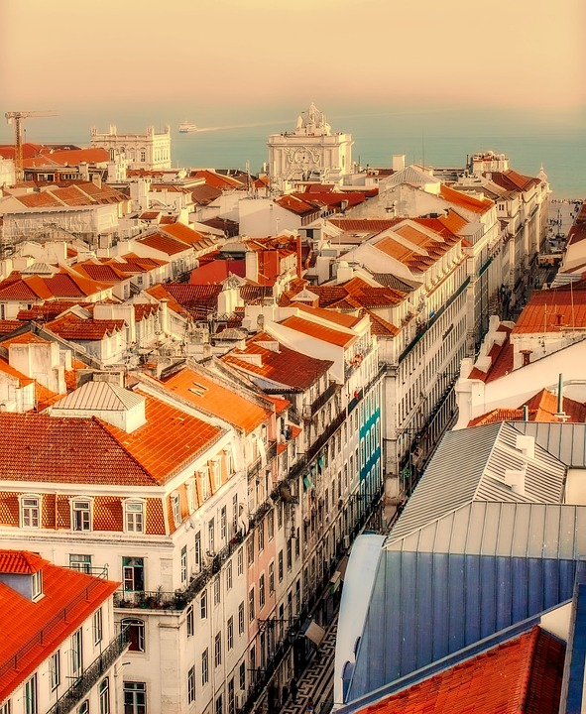
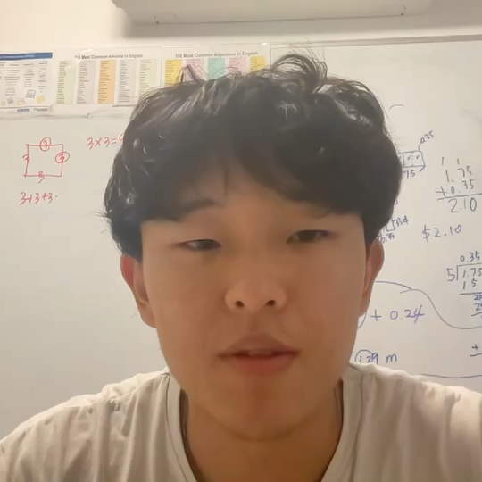
Thank you for listening!
Notes:
thank you for listening

